Slide 1
Project Question: Do lobbyist dollars affect congressional legislation?
Jennings Gamble

Slide 2
The Five Stages of Project Question Writing
Optimism: How much do lobby dollars affect legislation? What are the trends across industries?
Less Optimism: How much do lobby dollars affect legislation in one industry?
Less Still: How much do lobby dollars affect legislation in one industry in one committee?
… : How much do lobby dollars affect legislation for a single congressperson?
Please just compile

Slide 3
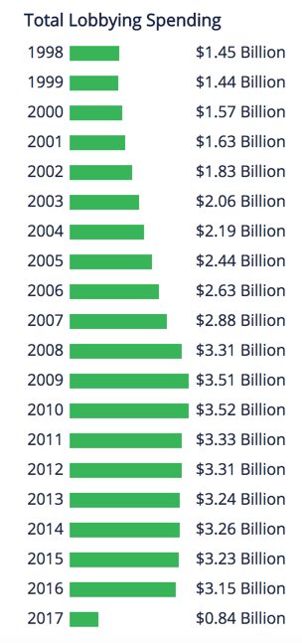


Data Sources – GovTrack

Slide 4
Initial Methodology
BioGuide
Senator Name
GovTrack ID
Work History
GovTrack
Senator Name
GovTrackID
BioGuideID
USID (Open Secrets ID)
PVSID (VoteSmart ID)
GovTrack
Voting Record
Chart effectiveness of Lobbying dollars by industry
VoteSmart
Voting Record
OpenSecrets
Contributions by Industry

Slide 5
Final Methodology

Slide 6
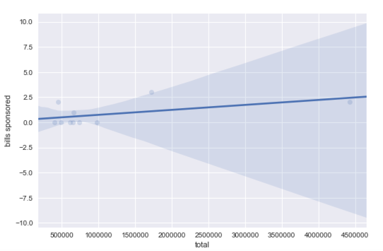
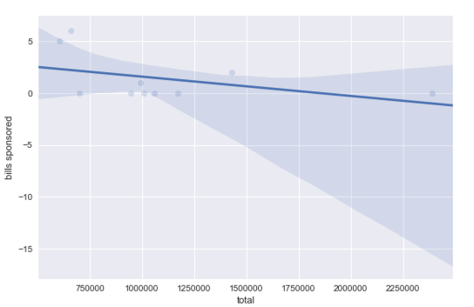
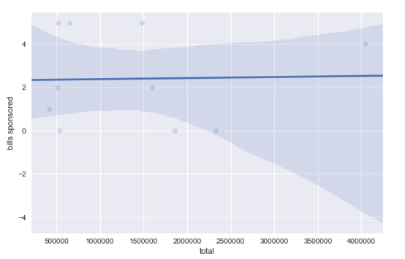
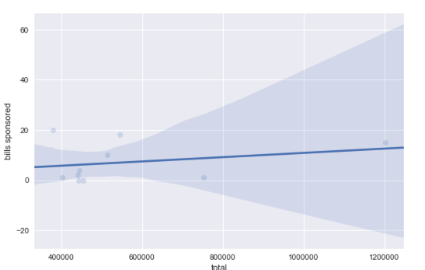
What did the data look like?
Paul Ryan
Mitch McConnell
Elizabeth Warren
Orrin Hatch
*2016 Data

Slide 7
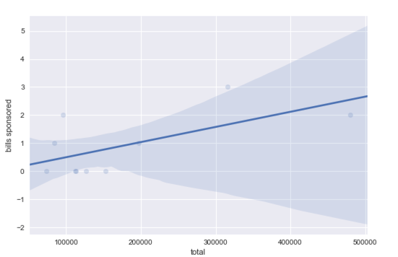
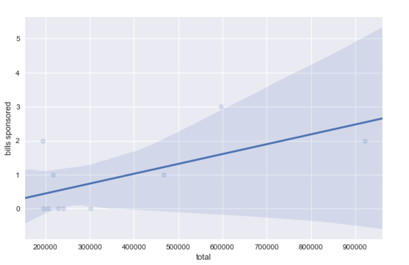
Paul ryan through the years
Paul Ryan 2012
Paul Ryan 2014
Notice the difference in axis with the 2016 data! Elected as speaker of the house on Oct 29th 2015
Lobbyist John David Hoppe named as his chief of staff. Used to lobby on behalf of Sheldon Adelson, who owns the Sands Corporation in Las Vegas. Fun Fact: he was the largest donor (of any party) to both the 2012 and 2016 presidental races.
Paul Ryan 2016

Slide 8
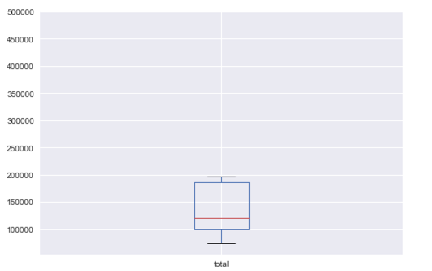
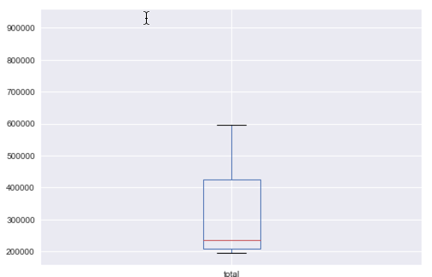
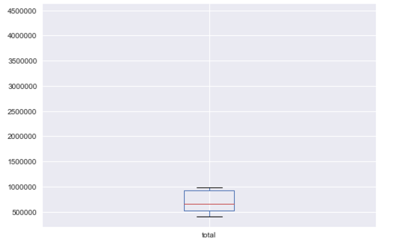
Paul ryan through the years
Paul Ryan 2012
Paul Ryan 2014
Paul Ryan 2016

Slide 9
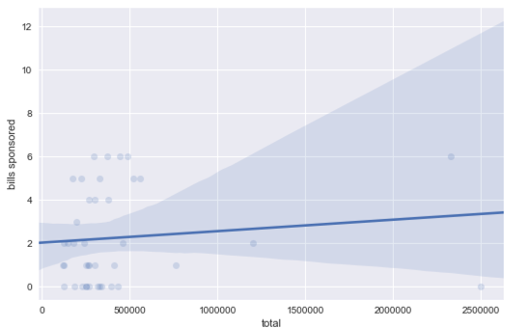
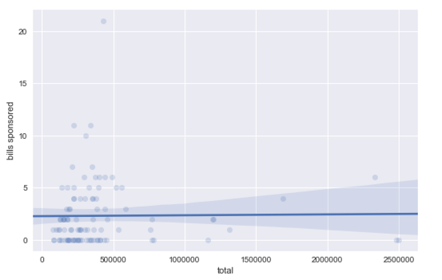
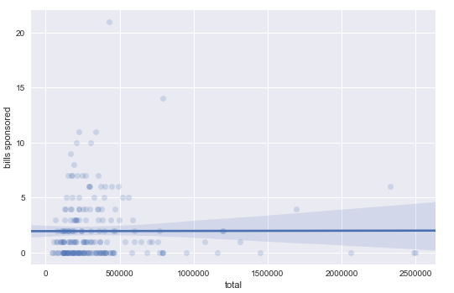
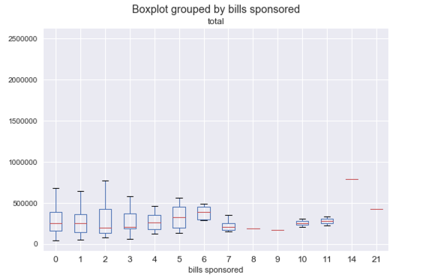
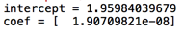
Senate committee of the environment and public work
N = 4 senators
N = 10 senators
N = 21 senators

Slide 10
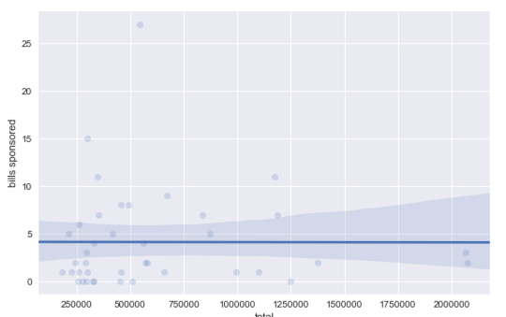
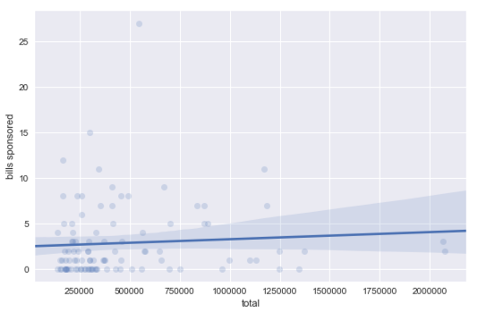
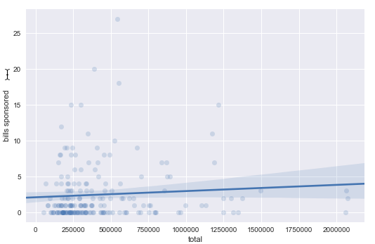
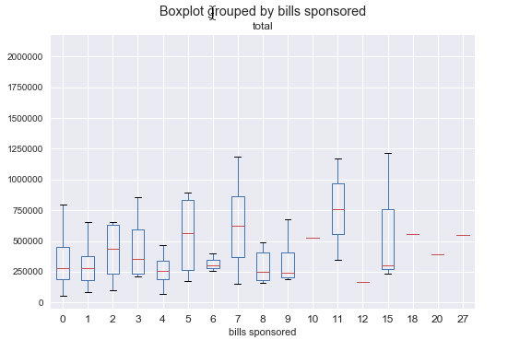
Senate committee on the judiciary
N = 4 senators
N = 10 senators
N = 20 senators

Slide 11
Questions?

